Slide 1
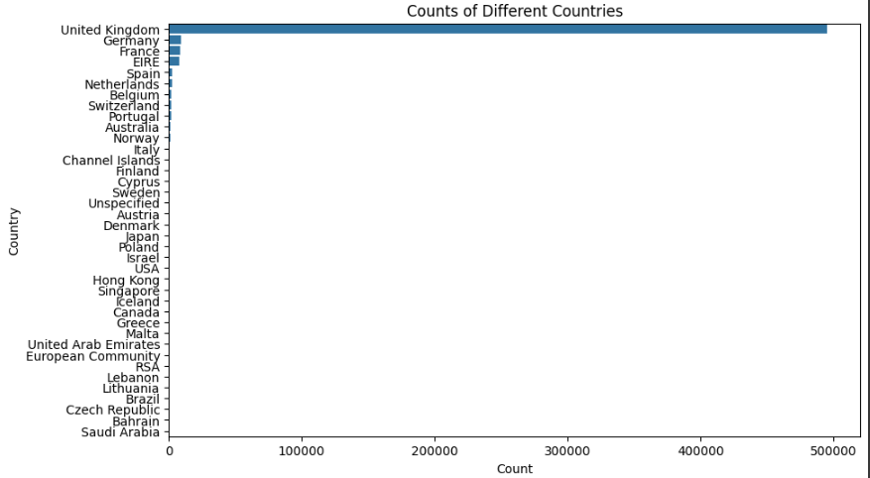
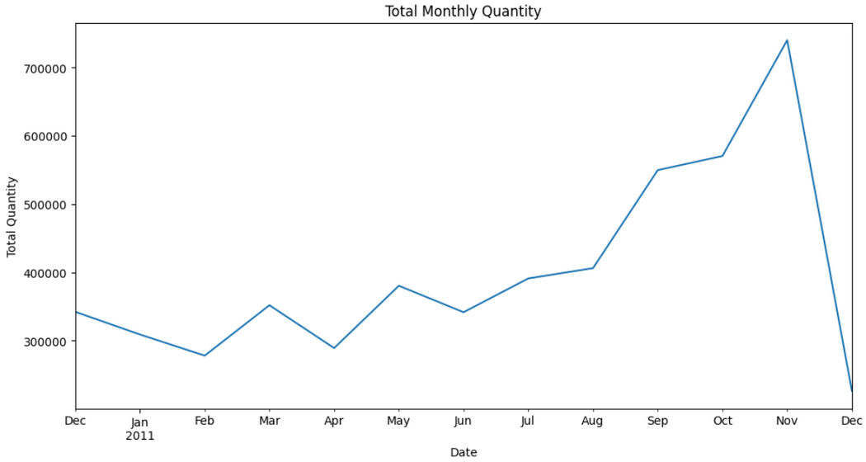
Name : Md Arifur Rahaman
ID : 2014198642
Title: EDA of E-Commerce Dataset
Introduction
This analysis explores the "Online Retail" dataset, containing transactions from a UK-based online retailer between December 2010 and December 2011. The objective is to understand sales trends, customer behavior, and product performance
Key Insights
The top 10% of customers contribute to 60% of the total sales revenue.
The UK accounts for 85% of sales, followed by Germany and France with 5% and 3% respectively.
A significant spike in total monthly quantity is observed in November, followed by a sharp drop in December
The quantity distribution is highly skewed with a large concentration around zero.
Low correlations exist between Quantity, UnitPrice, and CustomerID, indicating these variables do not significantly influence each other.
Summary Statistics:
Total Records: 541,909
Number of Products: 4,070
Number of Customers: 4,284
Time Period: Dec 2010 - Dec 2011

Slide 2
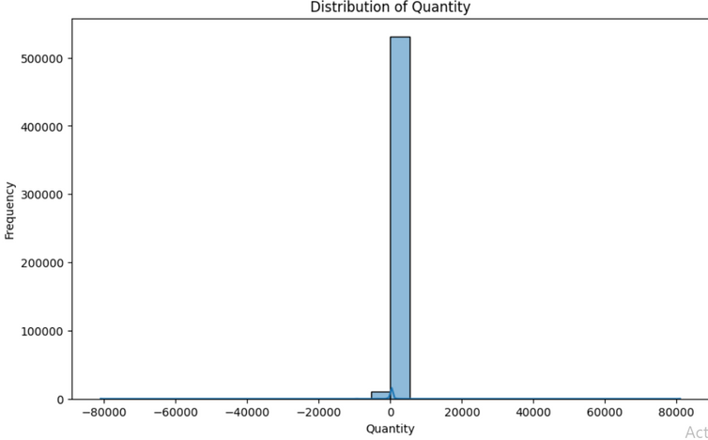
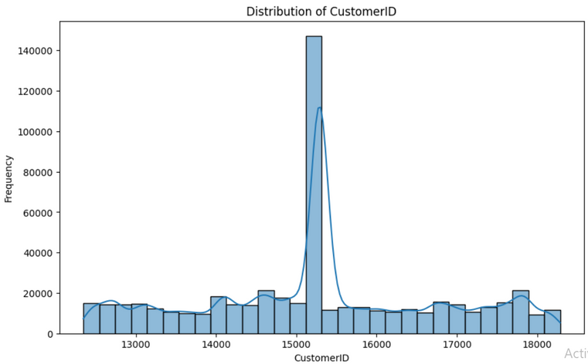
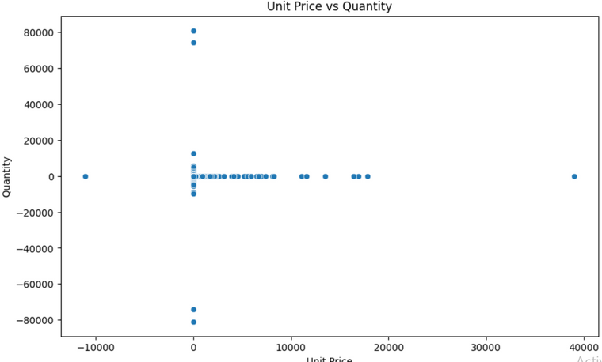
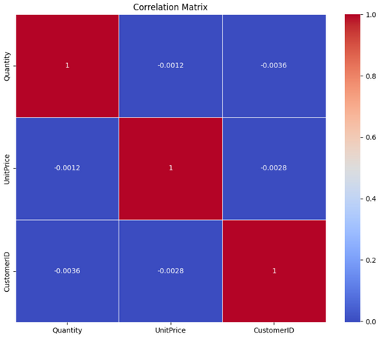
Visualizations and Patterns
The scatter plot shows most transactions are concentrated around low unit prices and low quantities, with a few extreme outliers. This indicates typical transactions are small and inexpensive, while large or costly orders are rare.
The distribution of CustomerID shows a significant peak around 15000, indicating a high concentration of transactions from repeat customers. Outside this peak, CustomerIDs are relatively evenly distributed, suggesting a diverse customer base.
the spike in total quantity in November, indicating a possible seasonal trend.
The scatter plot shows that bulk purchases are rare, as high unit prices or high quantity transactions are uncommon.
The United Kingdom's diverse range of unit prices suggests a wide variety of products being sold.
The correlation matrix indicates almost no linear relationship between quantity, unit price, and customer ID.
Annotations and Highlights
The scatter plot shows most transactions are concentrated around low unit prices and low quantities, with a few extreme outliers. This indicates typical transactions are small and inexpensive, while large or costly orders are rare.
The correlation matrix reveals negligible relationships among Quantity, UnitPrice, and CustomerID, with all correlation coefficients close to zero. This indicates that these variables are practically uncorrelated, suggesting that changes in one do not predict changes in the others.
Conclusion
The analysis reveals seasonal sales peaks, particularly in November, and highlights the dominance of low-value transactions. The findings suggest targeted marketing during peak seasons and addressing anomalies in low or zero-priced transactions. Further analysis should focus on customer segmentation and product-specific trends. between quantity, unit price, and customer ID.

